Slide 1
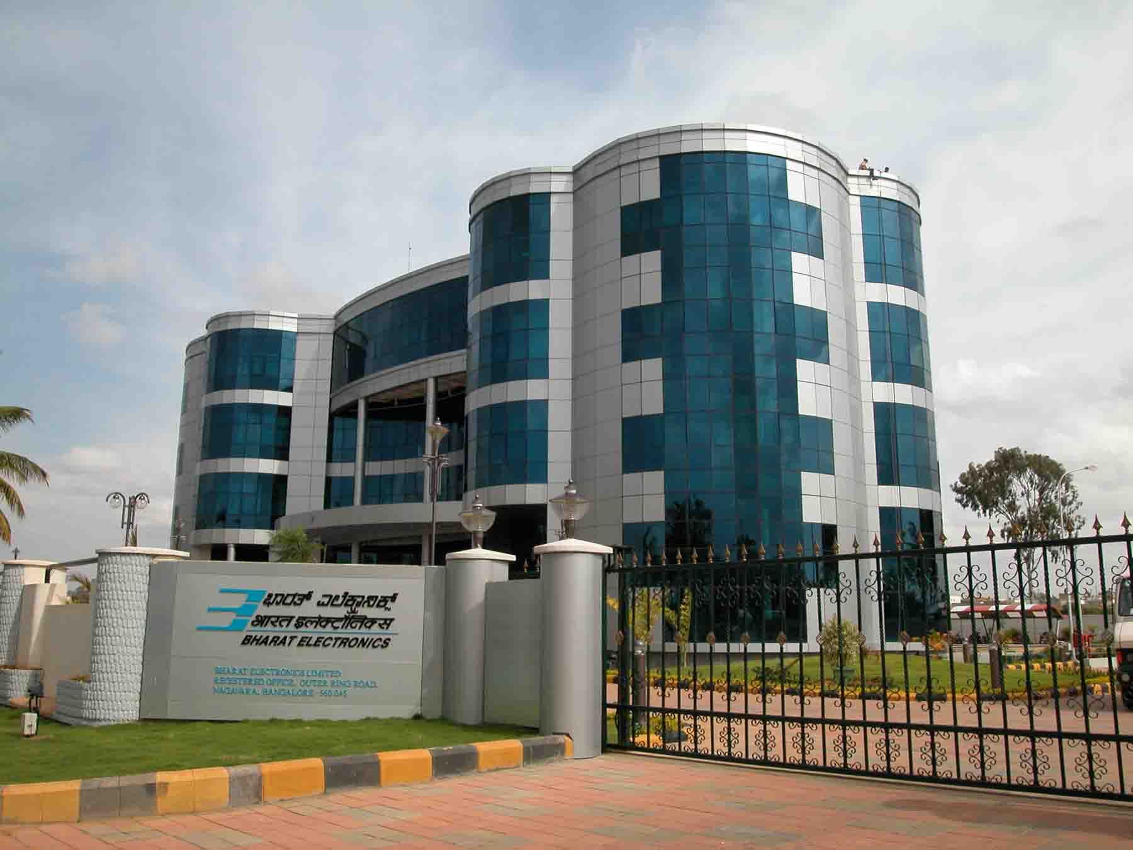
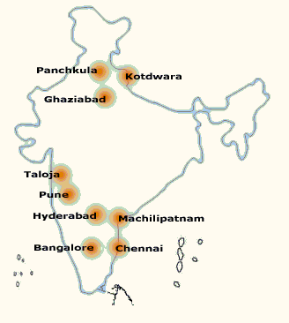
Bharat Electronics
www.bel-india.in

Slide 2
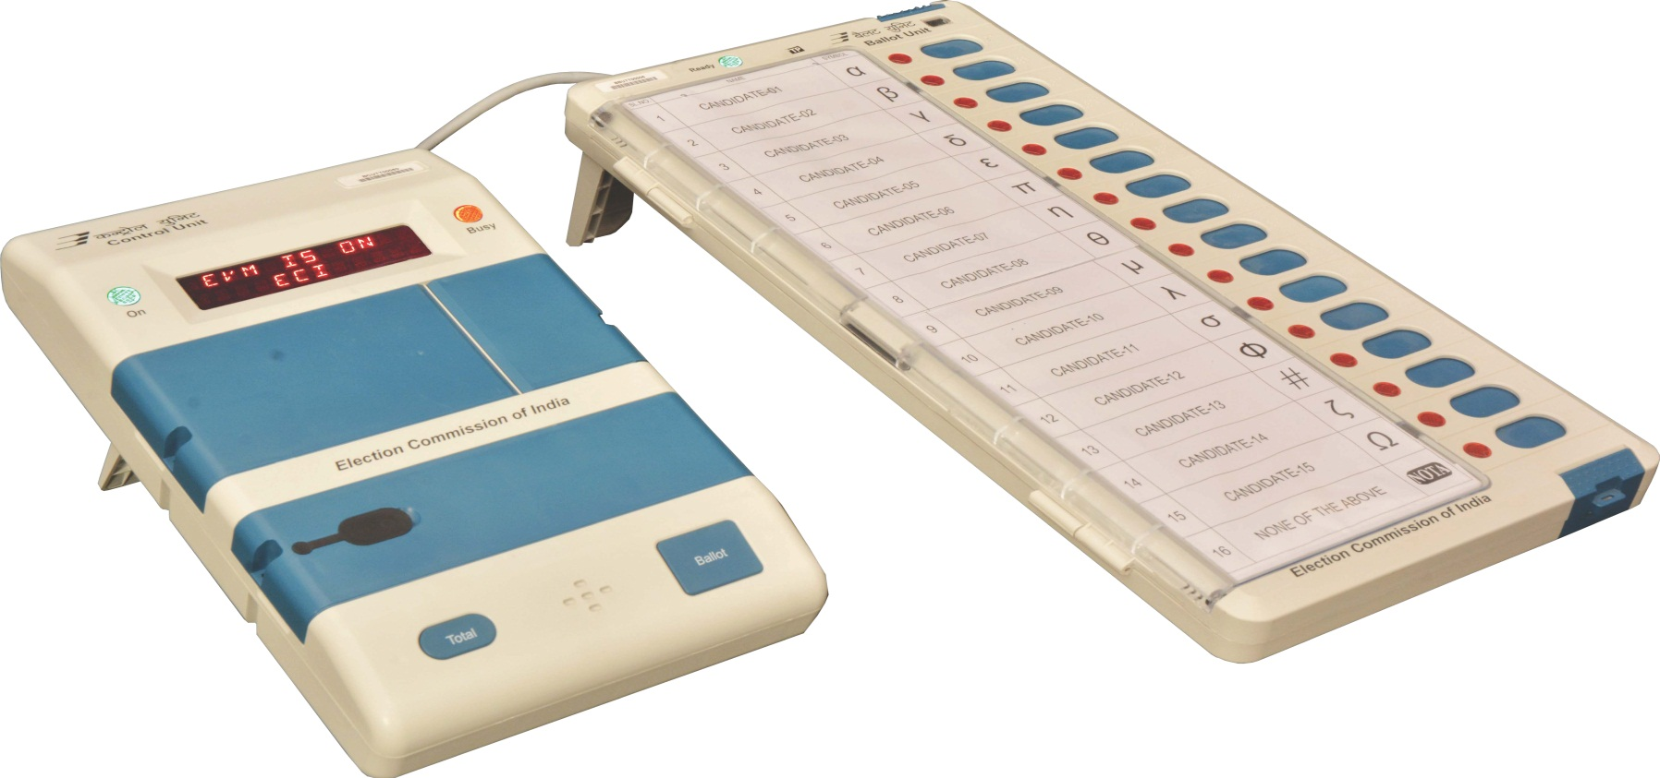
EVM
Commissioning of
Electronic Voting Machine (EVM)

Slide 3
EVM
Preparation (Commissioning) of EVM by Returning Officers (RO)

Slide 4
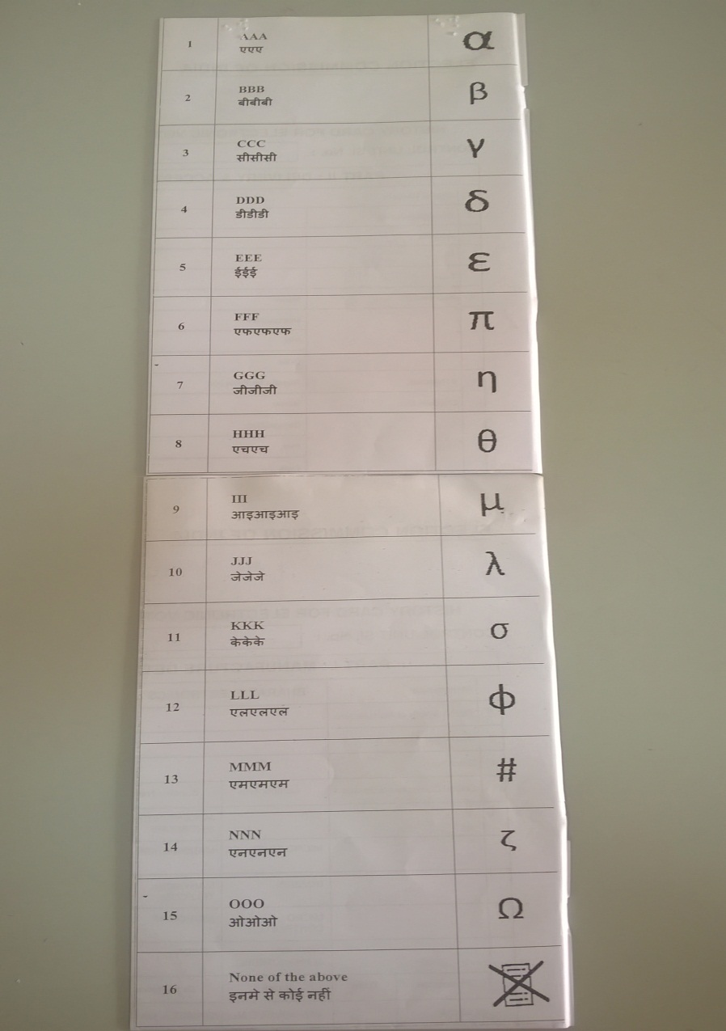
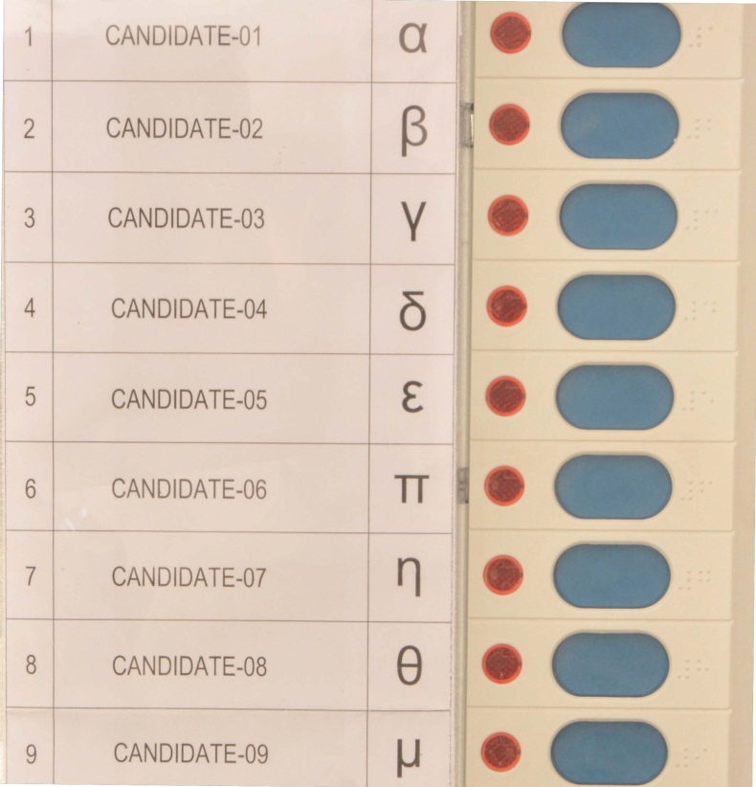
EVM - Ballot Paper Details
Candidate’s Name
Candidate’s Election Symbol
Candidate’s Serial No.

Slide 5
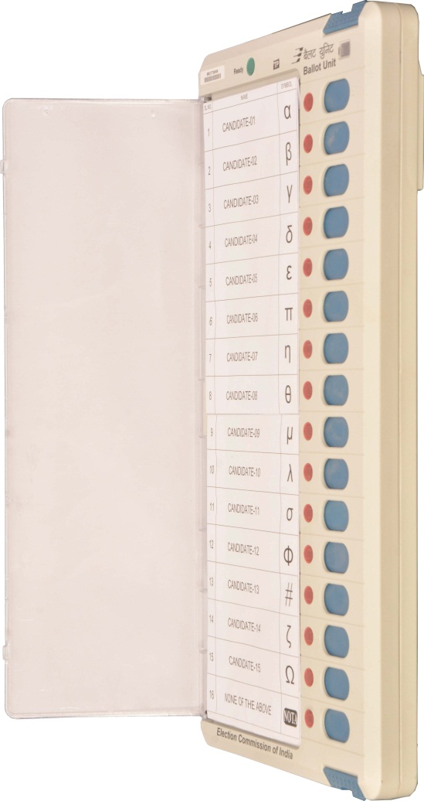
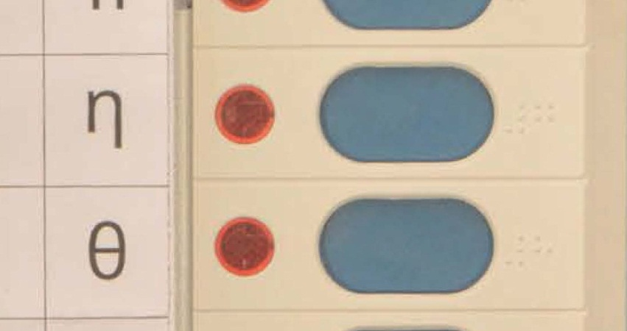
EVM - Fixing of Ballot paper
Fix ballot paper and ensure alignment of Ballot paper (align the partition line of ballot paper with the grooves on the cover)
Properly aligned
Ballot paper

Slide 6
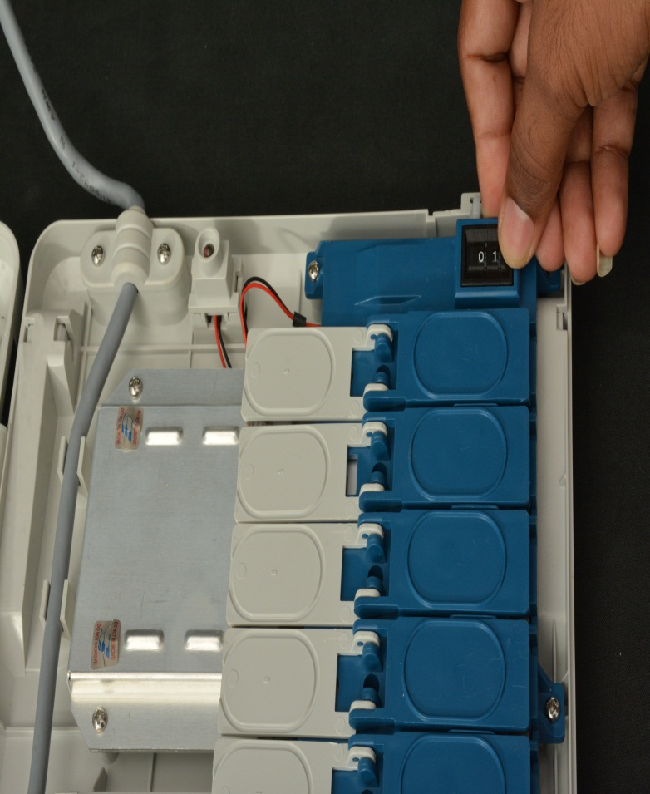
EVM – Ballot Units - Setting the Slide Switch
Set Thumb Wheel to:
Rotate wheel to
set position
Position “1” in Ballot Unit 1 if the candidates are 16 or less
Position “2” in Ballot Unit 2 for candidates between 17 and 32
Position “3” in Ballot Unit 3 for candidates between 33 and 48
Position “4” in Ballot Unit 4 for candidates between 49 and 64

Slide 7
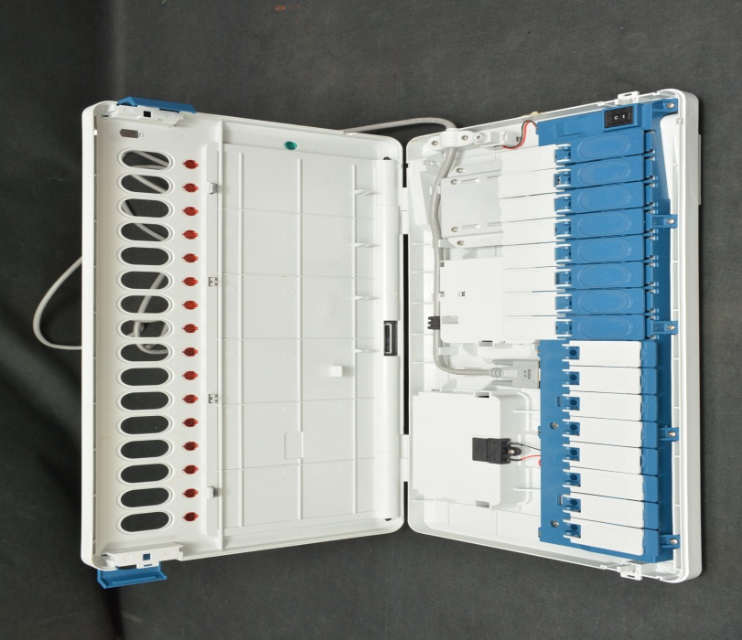
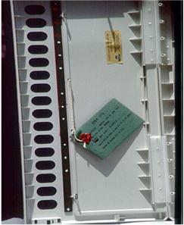
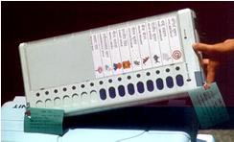
EVM – Ballot Unit
Masking/Unmasking of Candidate’s button
Mask Unused Candidates buttons
Candidates button
Seal Inner compartment with Tags
Masked button
Masking Flaps
Close the Ballot Unit Cover
Seal with tags at the top and bottom latch covers

Slide 8
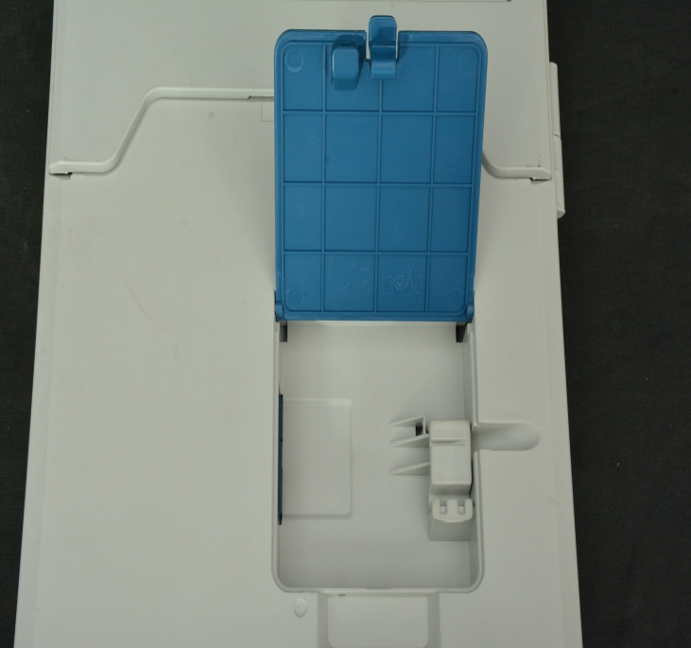
EVM – Ballot Units - Cascading
In case more than one BALLOT unit is being used….
Rear portion of Ballot Unit
Connect the Second Ballot Unit to the First Ballot Unit by connecting the interconnecting Cable of the Second Ballot Unit to the Connector available in the Connector Box in the rear of the First Ballot Unit.
The Third Ballot Unit should be similarly connected to the Second and the Fourth Ballot Unit to the Third.
Connector for Additional Ballot Unit
In case more than 4 BALLOT unit is being used, Insert EVM battery into Back side of BU after each 4 Bus (Like 5th,9th,13th,17th,21st BU).

Slide 9
EVM – Ballot Unit
Fixing of Pink Seal – Pink seal is pasted on Ballot Unit at the end of Preparation of Ballot Unit.
Address Tags are tied with details of Polling Stations.

Slide 10
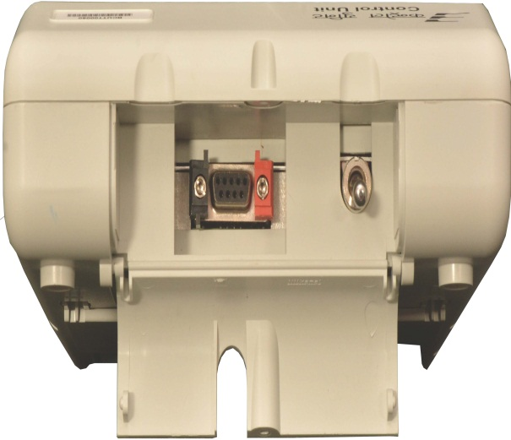
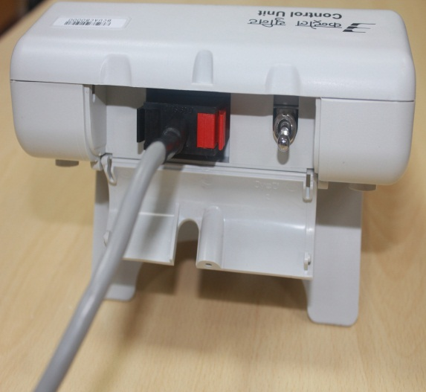
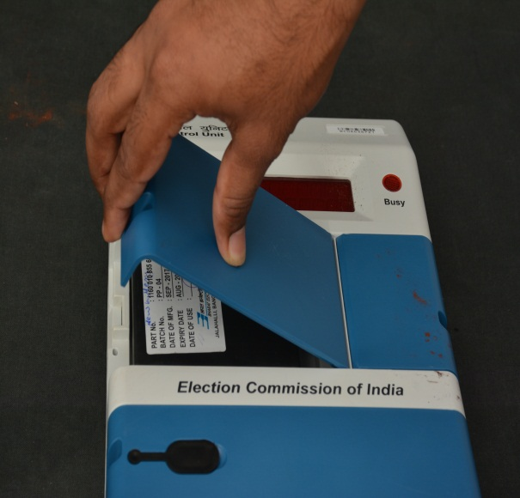
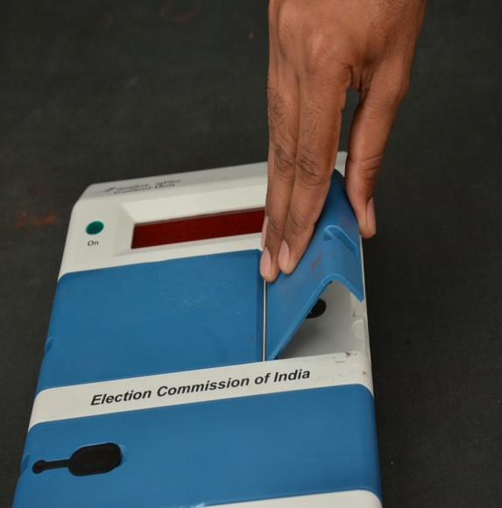
EVM - Preparation of Control Unit
Open bottom compartment and CONNECT Ballot Unit cable connector by pressing the hood of the connector
Open Candidate Set section outer door pressing the latch and lifting the cover
Remove Seal on the new Power pack (unused) and fix in Control Unit by plugging in

Slide 11
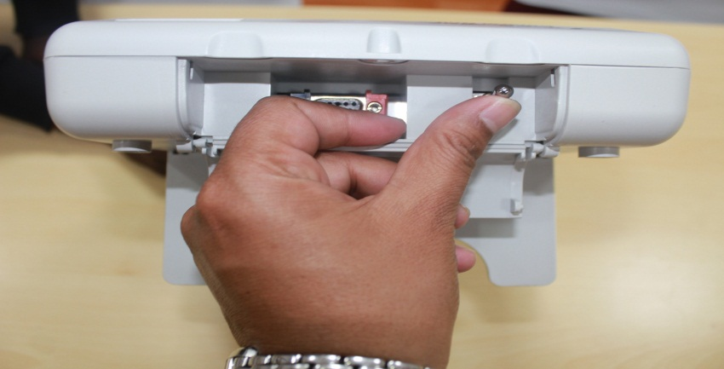
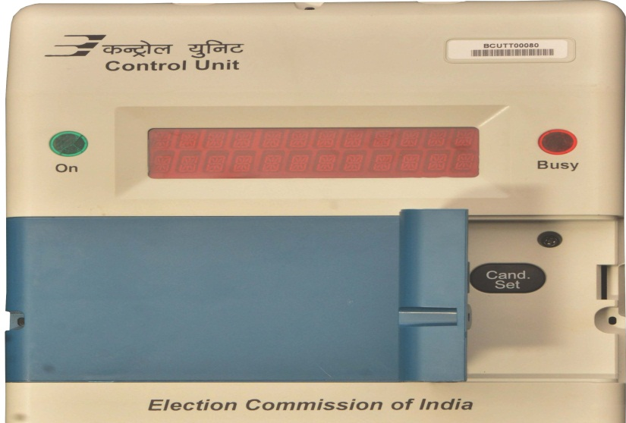
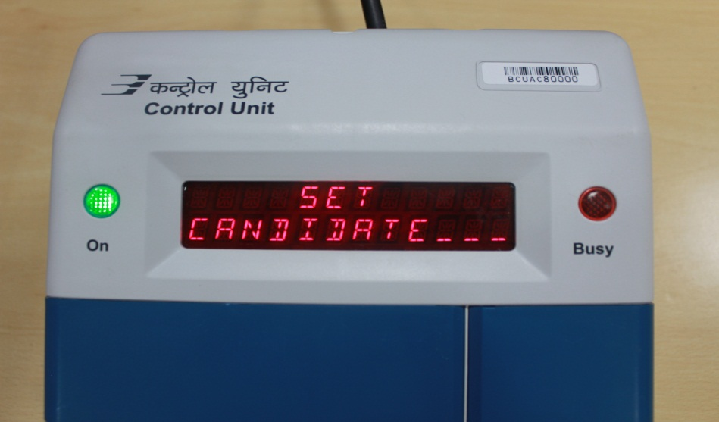
EVM – Candidates Setting
Switch ON the Power using the toggle switch
Open the Candidate Set door
Press Button on Control Unit and observe the display flashing with Beep
Cand. Set
SET CANDIDATE

Slide 12
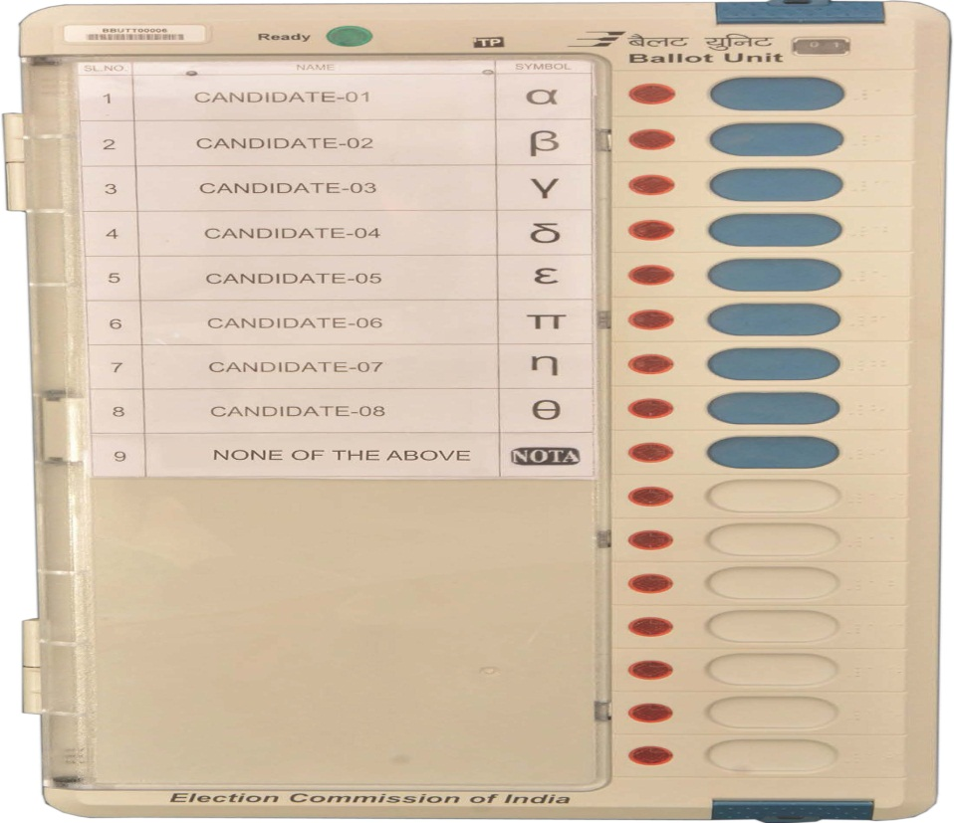
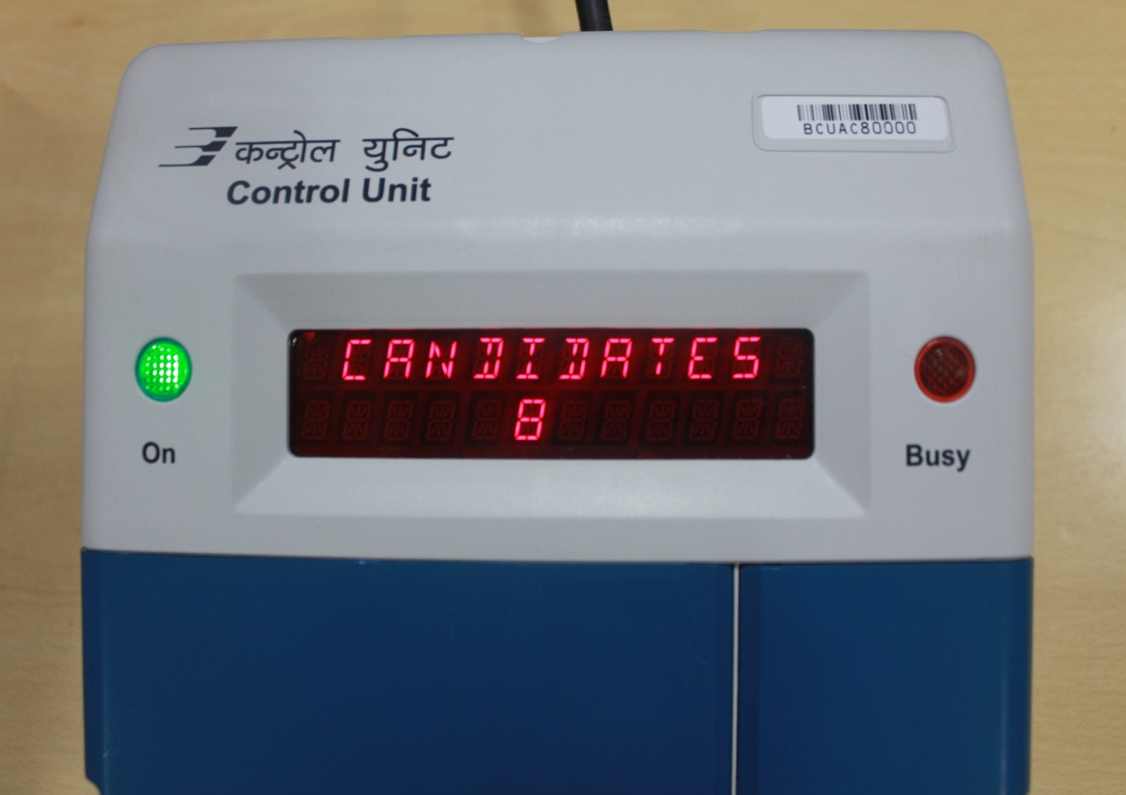
EVM – Candidates Setting
Press the last unmasked Blue Candidate Button on Ballot Unit to set candidates. For e.g., if number of candidates is 8, then is displayed on Control Unit
CANDIDATES 8

Slide 13
EVM – Candidates Setting
When button is pressed, if the digit display panel shows the words
, It signifies that the data relating to some previous operation is in the EVM.
Cand. Set
INVALID
Press the button and wait till is displayed
Close
POLL CLOSED
Thereafter, press button and wait till is displayed
Result
END
Thereafter, press button and wait till is displayed
Clear
END
Then press button and flashes with Beep
Cand. set
SET CANDIDATE
Now press the last candidate’s button on the Balloting Unit

Slide 14
EVM – Candidates Setting - Sequence
Close
Result
Clear
Cand. set
Switch OFF & SEAL

Slide 15
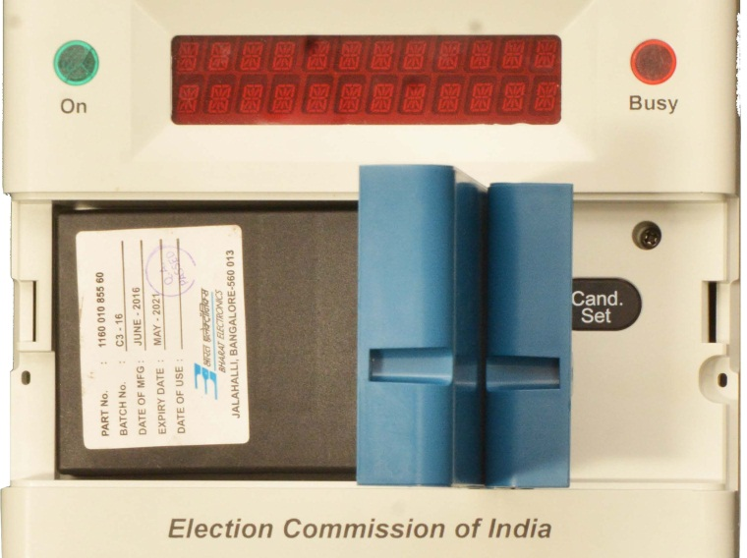
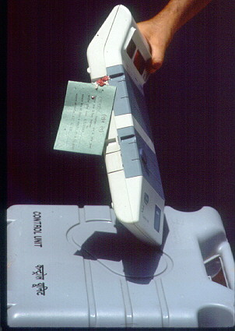
EVM – Control Unit
Preparation to distribute to Polling Parties
Switch OFF the Power and disconnect the Interconnecting Cable
Close & Seal the door of the Battery & Candidate Set Section
Seal the Outer door of the Candidate Set Section with an Address Tag

Slide 16
EVM – Control/Balloting Unit
Packing after preparation
Pack the prepared Control and the Ballot Unit in their Carrying cases
Tie the address tags on the carrying cases with threads
Thank You

Slide 17
Gist of activities on BU
Removing rubber pads and pasting of new rubber pads,
Sample checking of rubber pads
Sealing and storage of discarded rubber pads with due record
Fixing of ballot papers with facsimile stamping at the back,
Unmasking of tabs ( candidate +NOTA) ,
Setting of thumb wheels ( as per no of BUs)
Pasting of PPS,
Fixing of address tags ( 4 nos),
Pasting of Identification number,
Putting the machines in Plastic Cover

Slide 18
Gist of activities on CU
Removing rubber pads and pasting of new rubber pads,
Sample checking of rubber pads
Sealing and storage of discarded rubber pads with due record
Setting of power pack
Candidate Setting
Switching off the machines after C-R-C
Fixing of address tags ( 3 nos),
Pasting of Identification number,
9. Putting the machines in Plastic Cover

Slide 19
Material requirements
Ballot paper
PPS for BU,
Power packs for CUs, VVPATs,
Paper Roll for VVPATs ( Special variety ,if allotted)
Address tags
Other Stationary articles
Sealing articles
Facsimile of RO
Metal stamp of RO
Rubber stamps-a) Testing VVPAT slips, b) Mock Poll slips
Red and Green envelops
Table wise check list
Movement list of machines, BPs, PPS –table wise, round wise,

Slide 20
MOCK POLL OF EVM
After candidate setting one MOCK POLL in each button of B.U including NOTA
VVPAT slips stamped at their back side with rubber stamp- TESTING VVPAT SLIP – VVPAT COMMISSIONG
Keep MOCK POLL Slip in RED Colour envelope SEALED with seal of RO
1000 MOCK POLL Slip Stamped at their back side with rubber stamp- MOCK POLL SLIP – EVM COMMISSIONG should be kept in GREEN COLOUR envelope SEALED with seal of RO

Slide 21
(Register for Preparation of EVMs)
ANNEXURE-15
Name of State /UT :
Name of District :
Name of Assembly/ Parliamentary Constituency :
Address of Preparation of EVM hall :
Date :
Sl No | Name of Candidate | Name of Representative of candidates with party affiliation , if any | Identity document No. with date | Signature of Candidates/His representative | Remarks, if any.
Note : If a candidate or his representative is absent the proof of due service of notice to the candidate should be pasted in the register.
(Name and signature of engineers of BEL/ECIL with ID No.)
(Name, designation, signature of officers nominated by District Election Officer)

Slide 22
(Certificate of EVMs by BEL/ECIL)
ANNEXURE-16
Name of State /UT :
Name of District :
Name of Assembly/ Parliamentary Constituency :
Address of hall :
Date :
It is certified that tests prescribed by BEL/ECIL to ascertain that all components are original were carried out on the Balloting Unit listed below on …………(date). On the basis of these tests it is certified that all components of the Balloting Unit listed below are original.
BU Identification No.
(Name & signature of BEL/ECIL engineers with ID No.)

Slide 23
(Mock Poll certificate during Preparation of EVMs)
ANNEXURE-18
Name of State /UT : Date :………………
Name of District :
Name of Assembly/ Parliamentary Constituency :
Address of hall :
It is certified that during commissioning of EVMs and VVPATs, mock poll of 1000 votes have been cast on 5% randomly selected EVMs, as well as VVPATs. The electronic result tallied with paper count, picked up by me. There are no discrepancies between the votes polled during the mock poll.
Sl No | Name of Candidate | Name of Representative of candidates with party affiliation , if any | Identity document No. with date | Signature of Candidates/His representative | Remarks, if any.

Slide 24
(Register for Sealing of Balloting Unit of EVMs using Pink Paper Seal)
ANNEXURE-19
Name of State /UT :
Name of District :
Address of FLC hall :
Date :
It is certified that the sealing of the Balloting Units using Pink Paper Seals has been done in my presence. I have put my signature on the Pink Paper Seals after sealing of the Balloting Units and I am satisfied with the sealing of the Balloting Units.
Sl No | Unique ID No. of Balloting Unit | Pink Paper Seal Number
Sl No | Name of Candidate | Name of political party with party affiliation , if any | Identity document No. with date | Signature of Candidates/His representative

Slide 25
